Slide 1
Car Buying System
PROG 24178 Object Oriented
Java 2
Professor: Georg Feil
Group Members: Vladyslav Banasko and Jonathan Scott

Slide 2
Purpose of Our Application
To allow the use to see a list of available cars
To allow the user to select a car for purchase
To allow the user to put a car up for sale

Slide 3
Technologies Used in Our Application
Our project was developed in Eclipse
We used JavaFX to create all of our graphical user interfaces(GUI).
File I/O was used to store cars available for purchase
Arraylists were also used to store all cars available

Slide 4
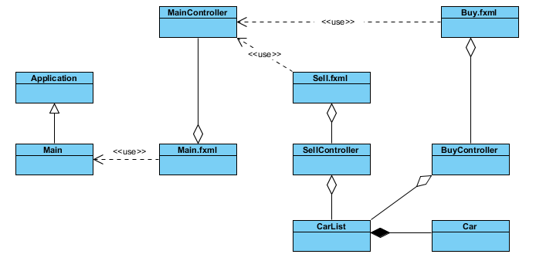
UML Diagram of Our Project

Slide 5
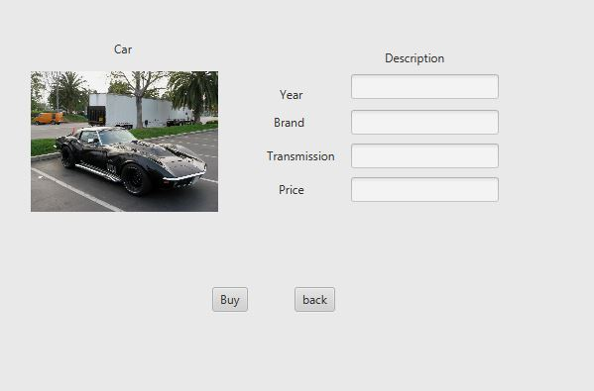
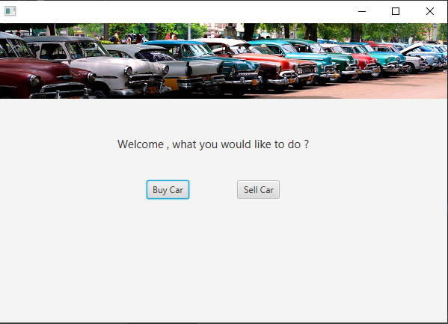
Changes from case study (first interface)

Slide 6
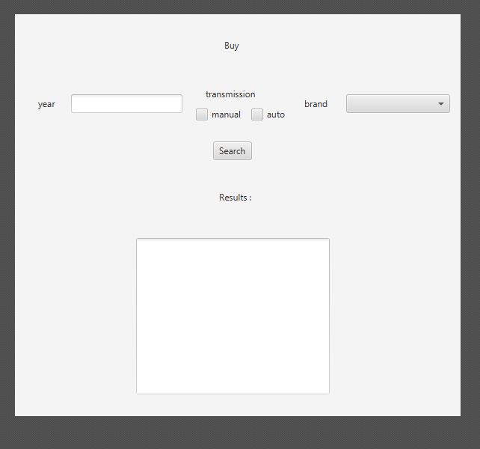
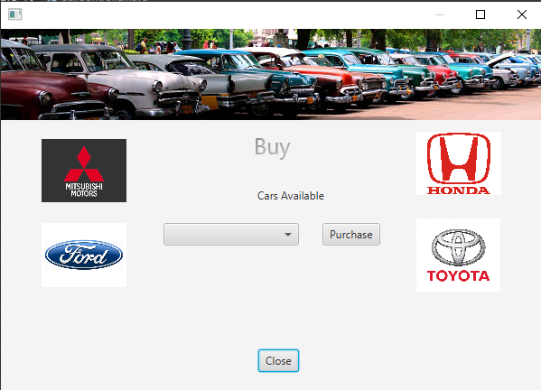
Changes from case study (second interface)

Slide 7
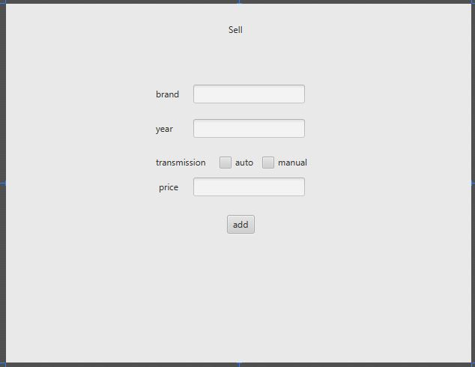
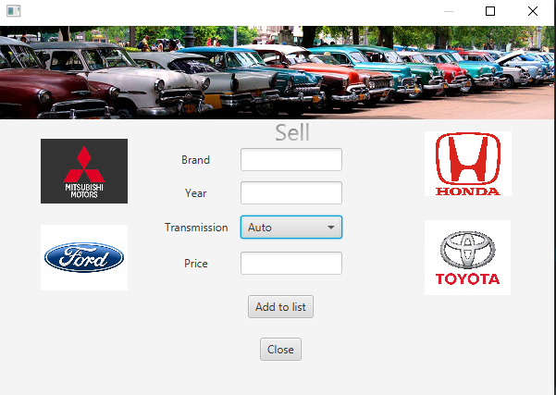
Changes from case study (third interface)

